Slide 1
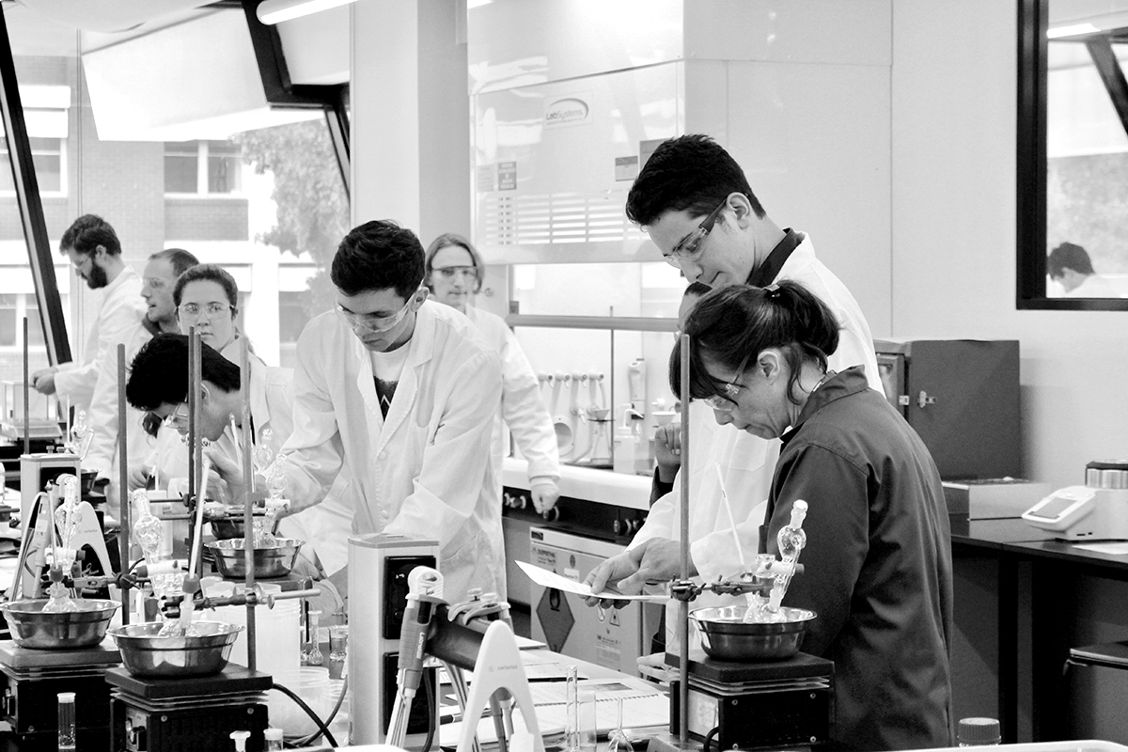
Authentic assessment as the cement of authentic learning in labs
Dr. Angela Ziebell
Jue Soo
Dr Stephen George-Williams
Dr Chris Thompson
Prof. Tina Overton
Notes:
How useful authentic assessment is in bringing the activity home. There are lots of examples of great authentic assessment out there but also many an authentic activity has it’s assessment as it’s weakest link for a variety of reasons. It’s the last thing to be put in place, unit coordinator doesn’t feel comfortable or have experience in how else to assess etc.
Intro – Transforming laboratory learning – 3 year project to revise labs for 17 different chemistry subjects. Almost 2 years in.

Slide 2
Authentic learning & assessment
Authentic – genuine, real. Using and applying knowledge and skills in a real world setting
In which students are asked to perform real-world tasks that demonstrate meaningful application of essential knowledge and skills (Meuller, 2014)
in similarity between thinking required for assessment task and real life situation (Savery & Duffy, 1995)
Use of same skills, knowledge, attitudes that would need to apply in professional life (Gulikers et al., 2004)

Slide 3
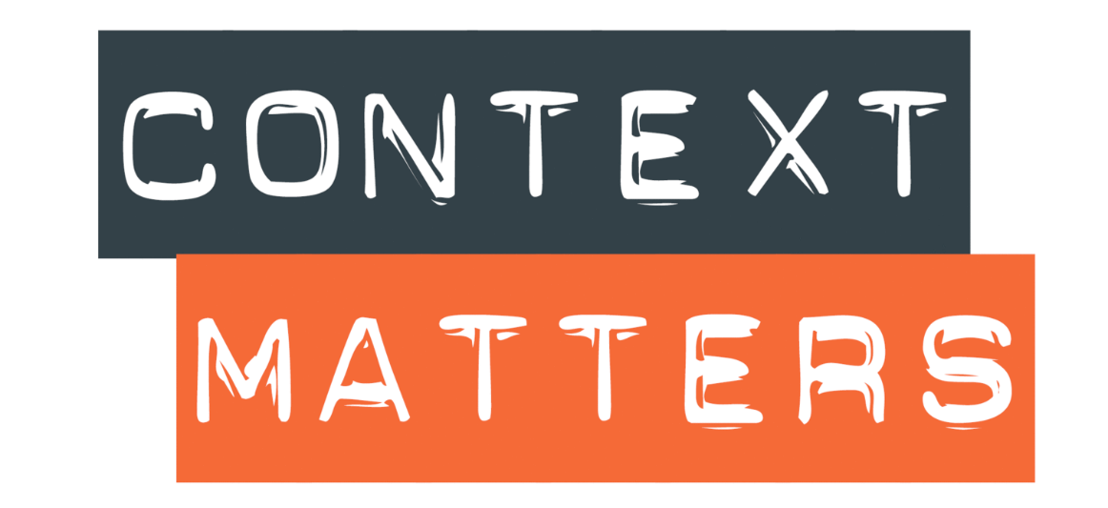
Mapping authenticity
Useful in informing the design of the lab
ASSESSMENT TASKS
Professional context
x
T&L ACTIVITIES
Student centred: skills
Teacher centred: knowledge
Academic
Lemanski and Overton , (2016),"The development of mapping tool for work-based learning
activities", Higher Education, Skills and Work-Based Learning, Vol. 6 Iss 3 pp. 277 - 287
Notes:
Focusing on context based learning as it is such a widely used learning format and it is always an obvious first step when you are improving existing labs. A large number of expository labs can easily be adapted by the addition of context. This is not a matter of jamming context and lab together. Interestingly I found that the act of adding context helps evolve the existing lab in very positive ways. E.g. faced with needing to process more samples you might more to a more high through-put analytical technique like reading samples in a plate reader. Plate readers are often used in the work place and are central to many testing platforms (both research and clinical). Now the lab exposes them to a new work place relevant skill, but the prac sits naturally with the story.

Slide 4
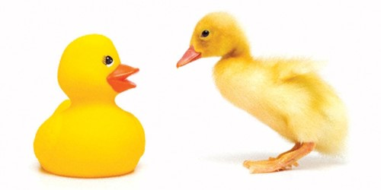
Principles of authenticity
Assessment must be aligned to instruction (Biggs, 1994)
Students demonstrate competencies through significant and meaningful tasks (Wiggins, 1993)
Authenticity is subjective. Must be perceived as authentic to students to influence learning
Task mimics professional role
Teaching staff must be on board

Slide 5
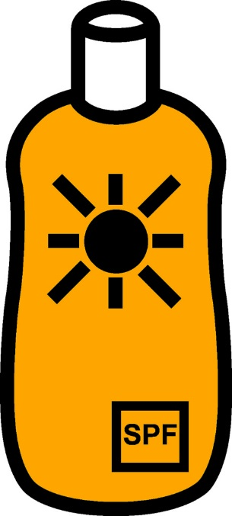
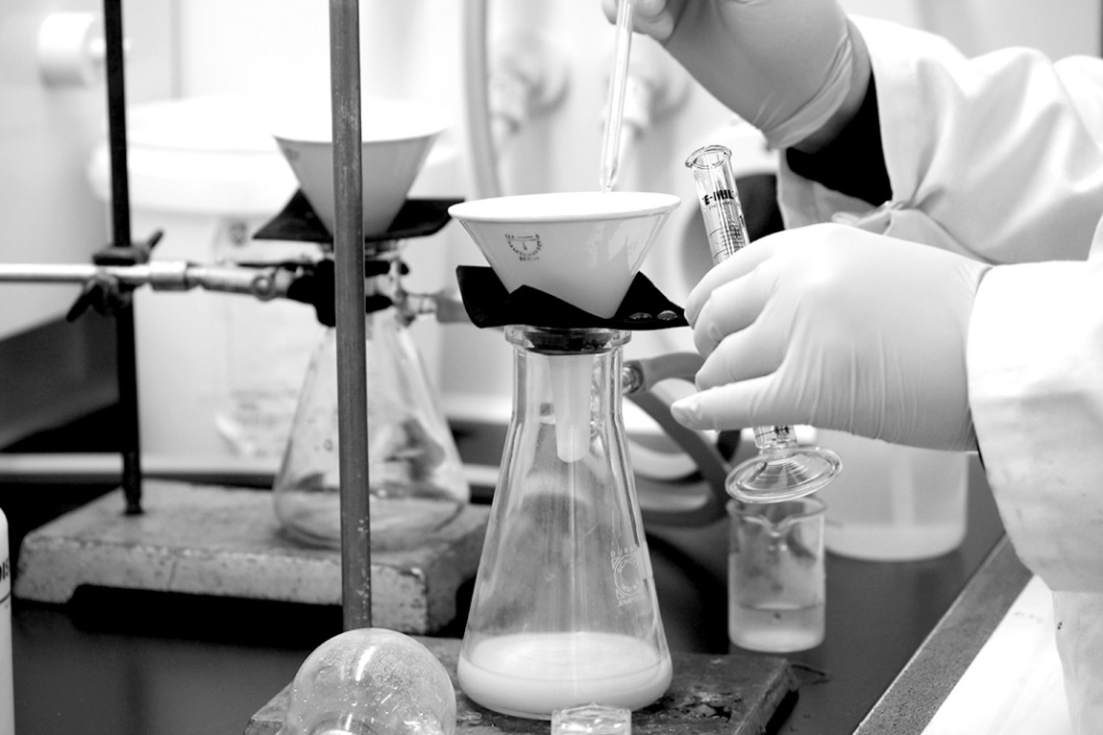
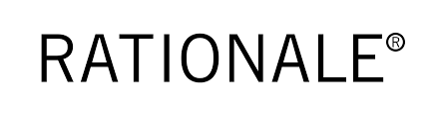
From Claisen-Schmidt synthesis to developing sunscreen
Traditional lab that worked well chemically (2nd year)
Found a context and industrial partner
Alter to teams, members make related compounds
Directly assess properties
Executive summary as part of the assessment
Notes:
Would have been quite a missed opportunity if the students were to have left the lab and not had to think about the commercial or industry context again for their lab write up. Students do heaps of student reports. They may still need to improve but volume alone will not achieve that. Student reports are relevant as they are a way to communicate scientific data and findings. In the work force there are many other writing styles needed and the practicing the writing style helps to communicate what the workplace environment will be like e.g. priorities, importance of brevity, easy reading and digestion of charts etc.

Slide 6
Not everyone appreciates the change
“The focus on the economics of chemistry, with particular regards to corporate profiteering, was horrible”
“the actual use of the product in protecting human health made secondary”
“this is a corruption of science…though I realise Monash probably doesn’t care given the corporate funding it surely receives.”
$...?...!

Slide 7

Importance of writing assistance
Sunscreen prac
Instructions
Mixed results
Plenty of great reports but missed the mark
Protein content in milks
Instructions incl. an example of a rewrite of a poor executive summary
Anecdotal feedback from demonstrators - more students grasped what an executive summary was.
Exemplars to come in 2018

Slide 8
Students feedback: Food Chem
One discussion recorded between students captures what we are trying to achieve with this initiative:
Student 1 “it felt more relevant than my other units”,
Student 2 “yeah, more than anything I've done before”,
Student 1 “it's like a legitimate almost work experience type situation ... the methods that you learn, they feel applicable to the real world.”
Notes:
Shows that “retrofitting” works

Slide 9
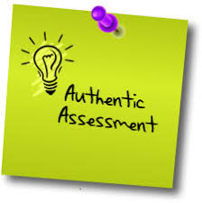
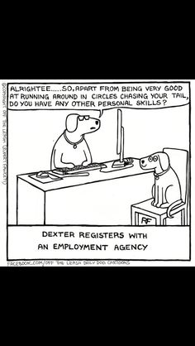
In summary
Authentic assessment has a large role to play in delivering a great WIL lab experience
  Informing modifications to the prac
  Making students aware of workplace considerations
  Engagement
Authentic assessment doesn’t have to be difficult
  Students need support
  Teaching staff are also likely to need support
  (applies to any new assessment)

Slide 10
Thanks
Monash Science Faculty for funding the “Transforming Laboratory Learning” project
The CERG group for support

